Slide 1


Top Down Parsing
p206 exercise 4.2.1: [24 pts.] Consider the context-free grammar:
and the token String : aa+a*
[5 pts.](1) Rewrite this grammar to left factor and eliminate left recursion.
[5 pts.](2) Compute First Set and Follow Set for the rewritten grammar.
[2 pts.](3) Is it LL(1) grammar, why?
[7 pts.](4) Construct the LL(1) parsing table.
[5 pts.](5) Match the input string aa+a* based on the parsing table and LL(1) algorithm.
G[S]: S→SS+|SS*|a

Slide 2
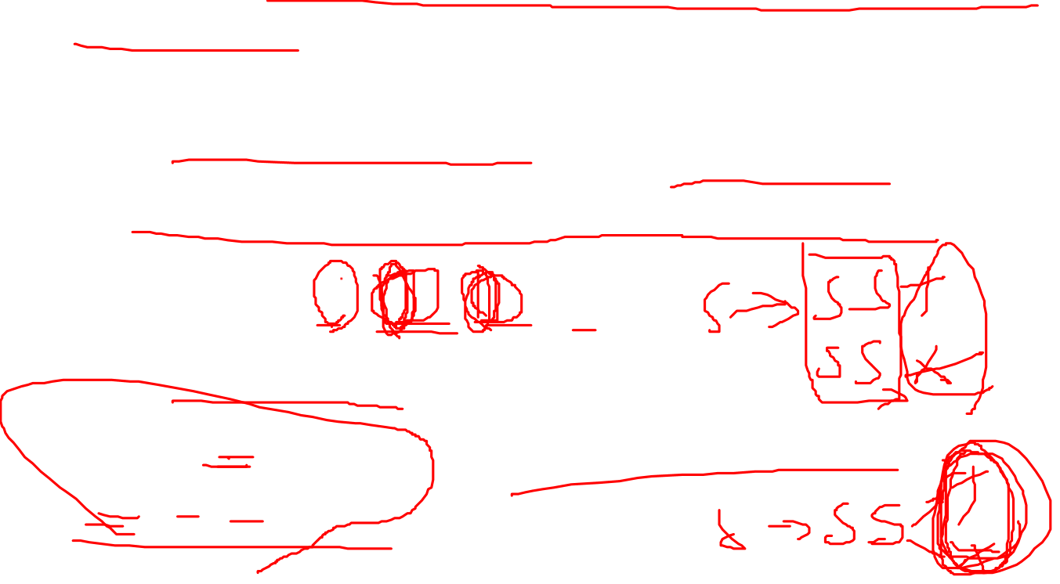
Top Down Parsing
(1) Rewrite this grammar to left factor and eliminate left recursion.
左因子和左递归
含有左因子和左递归文法一定不是LL(1)文法
通过提取左因子和消除左递归改写文法(rewrite)
Grammar : S→SS+|SS*|a
1）提取左因子：
S →SSO|a
O →+|*
需要进一步消除左递归

Slide 3
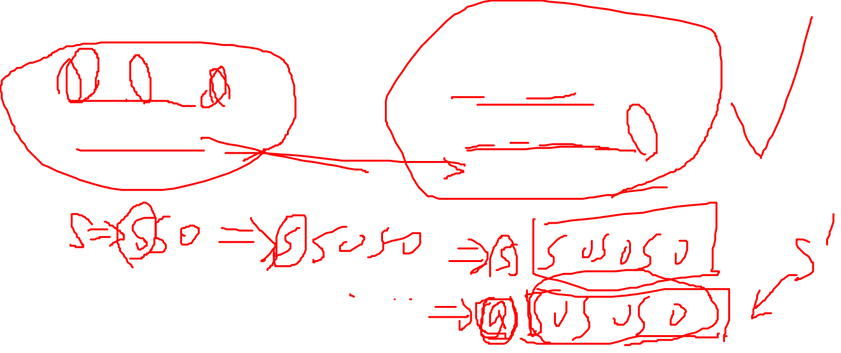
Top Down Parsing
左因子和左递归
含有左因子和左递归文法一定不是LL(1)文法
通过提取左因子和消除左递归改写文法(rewrite)
1）提取左因子：
S →SSO|a
O →+|*
2）消除左递归：
S →aS’
S’ → SOS’| ɛ
O →+|*

Slide 4

Top Down Parsing
(2) Compute First Set and Follow Set for the rewritten grammar.
计算nullable nonterminals
计算所有nonterminal的First Set
计算所有nonterminal的Follow Set
S →aS’
S’ → SOS’| ɛ
O →+|*
S’为Nullable

Slide 5
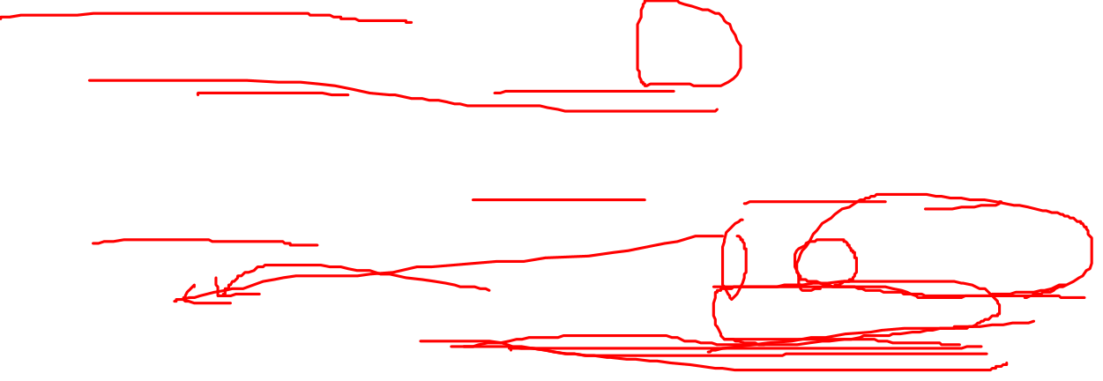
Algorithm for computing First(A) for each grammar symbol A (A∈V_{T} ∪V_{N} )
For all a∈ V_{T} , then First(a)={ a };
For all A∈ V_{N} ,if A ⇒*ε, then First(A)={ε} else First(A)={ } ;
For each production A→X1…Xj…Xn, First(A)=First(A)∪SectionFirst(X1…Xj…Xn);
Repeat step 3 until there is no change to any First set;

Slide 6

SectionFirst(X₁…X_{j}…X_{n})
SectionFirst(X₁…X_{j}…X_{n})
= (First(X₁) -{ε}) ∪(First(X₂)-{ε})∪… ∪(First(X_{j}) -{ε}) ∪First(X_{j+1})
X_{j+1} is the first symbol that is not nullable in the right-hand of production
if X₁ is not nullable, then SectionFirst(X₁…X_{j}…X_{n}) =First(X₁)
if X₁ is nullable, then SectionFirst(X₁…X_{j}…X_{n}) =First(X₁) -{ε}, and continue to see X₂. Stop until X_{i} is not nullable .
if X₁…X_{n} are all nullable, then SectionFirst(X₁…X_{n})= (First(X₁) -{ε}) ∪(First(X₂)-{ε})∪… ∪(First(Xn) -{ε}) ∪{ε}

Slide 7
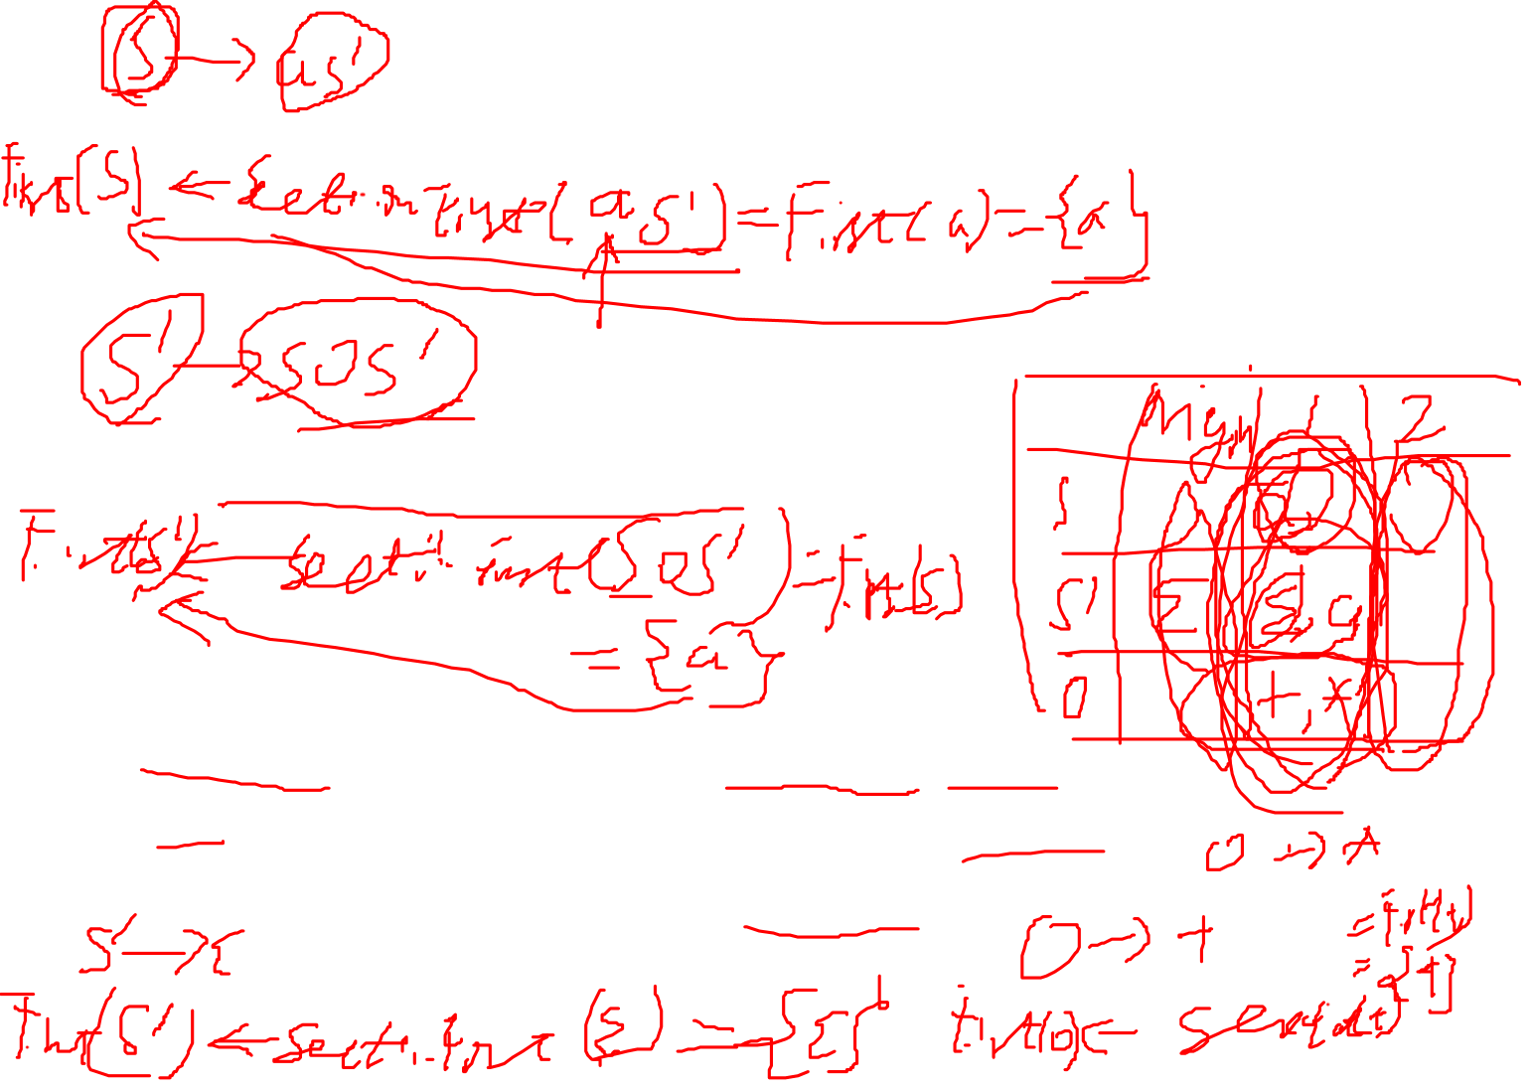
Top Down Parsing
(2) Compute First Set and Follow Set for the rewritten grammar.
计算所有nonterminal的First Set
S →aS’
S’ → SOS’| ɛ
O →+|*
First(S) ={ a }
First(S’) ={ ɛ , a }
First(O)={ +, * }

Slide 8

Compute FOLLOW(A) for every nonterminal A
S is the start symbol, Follow(S)={$};for all A∈V_{N}, and A≠S,Follow(A)={ };
For each production B→αAγ, for each A that is a nonterminal do
Follow(A)=Follow(A)∪(First(γ) -{ε})
if ε ∈ First(γ) then add Follow(B) to Follow(A)
Repeat 2,until there is no change to any follow set

Slide 9
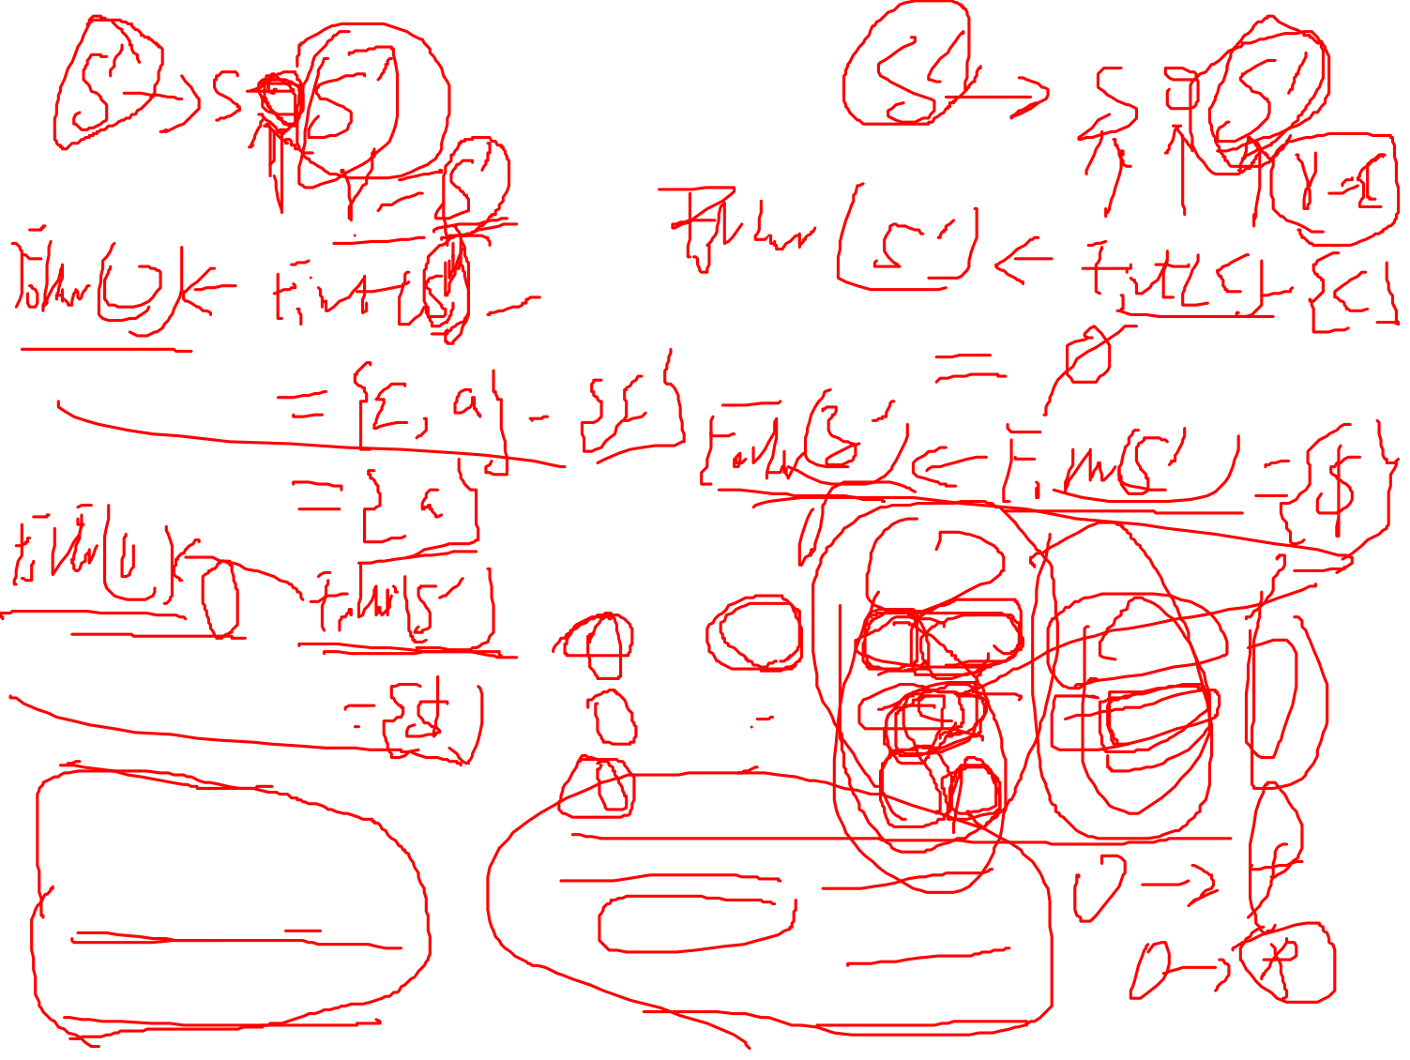
Top Down Parsing
(2) Compute First Set and Follow Set for the rewritten grammar.
计算所有nonterminal的Follow Set
 | Origin | Pass 1 | Pass 2
S | $ | $, +, * | $, +, *
S’ |  | $ | $, +, *
O |  | a, $ | a, $, +, *
S →aS’
S’ → SOS’| ɛ
O →+|*
First(S) ={ a }
First(S’) ={ ɛ , a }
First(O)={ +, * }
Follow(S) ={$, +, * }
Follow(S’) ={$, +, * }
Follow(O)={a, $, +, * }

Slide 10
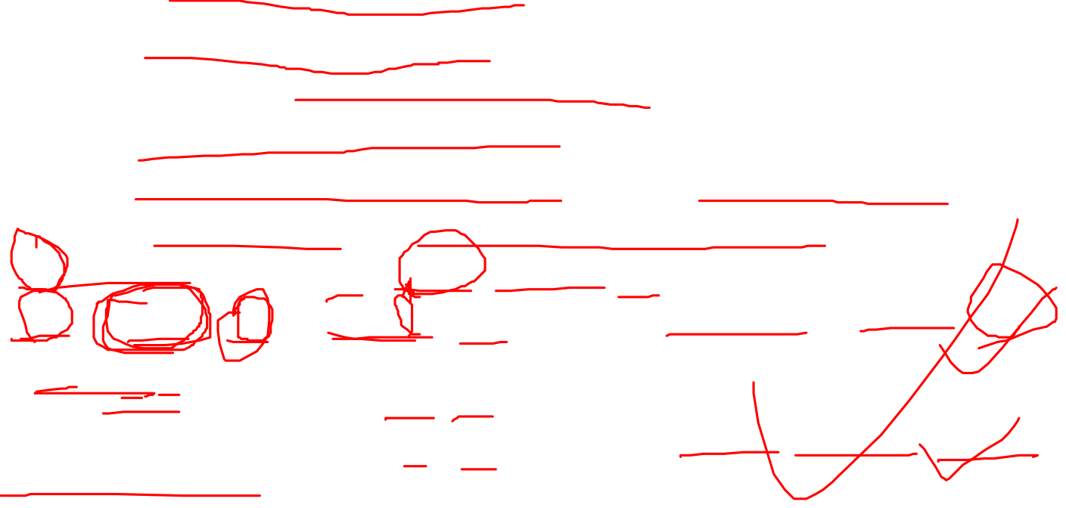
Top Down Parsing
(3) Is it LL(1) grammar, why?
针对同一nonterminal的多个产生式，计算其每一个产生式右部文法符号串的First Set，根据计算结果判定是否满足LL(1)的判定条件1
如果ɛ ∈First(nonterminal)，则根据该nonterminal的Follow Set判定是否满足LL(1)的判定条件2
S →aS’
S’ → SOS’| ɛ
O →+|*
First(SOS’)=First(S) ={a}
First(ɛ) ={ ɛ }
First(+)= {+}
First(*) ={*}
First(SOS’) ∩ First(ɛ) = Φ
First(+) ∩ First(*) = Φ
First(S) ={ a }
First(S’) ={ ɛ , a }
First(O)={ +, * }
满足LL(1)的判定条件1

Slide 11

Top Down Parsing
(3) Is it LL(1) grammar, why?
针对同一nonterminal的多个产生式，计算其每一个产生式右部的First Set，根据计算结果判定是否满足LL(1)的判定条件1
如果ɛ ∈First(nonterminal)，则根据该nonterminal的Follow Set判定是否满足LL(1)的判定条件2
S →aS’
S’ → SOS’| ɛ
O →+|*
Follow(S’)={$, +, *}
First(S) ={ a }
First(S’) ={ ɛ , a }
First(O)={ +, * }
First(S’) ∩ Follow(S’)={ ɛ , a } ∩ {$, +, *}= Φ
满足LL(1)的判定条件2 ,因此该文法是LL(1)文法!

Slide 12
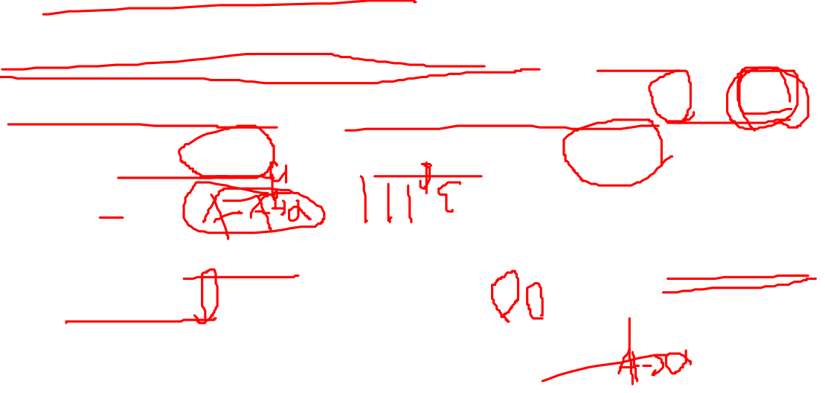
Top Down Parsing
4、构建LL(1)分析表
Repeat the following two steps for each nonterminal A and production choice A→ α
For each token ‘a’ in First(α), add A→ α to the entry M[A,a]
if ε is in First(α), for each element ‘a’ of Follow(A) (token or $), add A→ α to M[A,a]

Slide 13
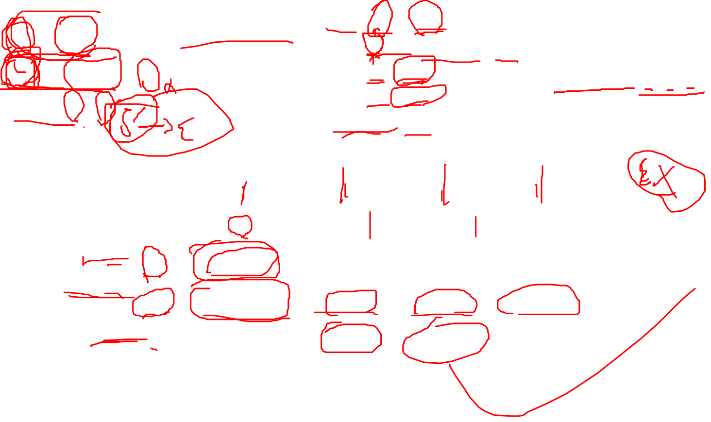
Top Down Parsing
First(aS’) ={a}
First(SOS’)=First(S)={ a}
First(ɛ)= {ɛ}
First(+) ={+}
First(*) = {*}
S →aS’
S’ → SOS’| ɛ
O →+|*
First(S) ={ a }
First(S’) ={ ɛ , a }
First(O)={ +, * }
Follow(S’)={$, +, *}
 | a | + | * | $
S | S→aS’
S’ | S’ → SOS’ | S’ → ɛ | S’ → ɛ | S’ → ɛ
O |  | O →+ | O →*

Slide 14
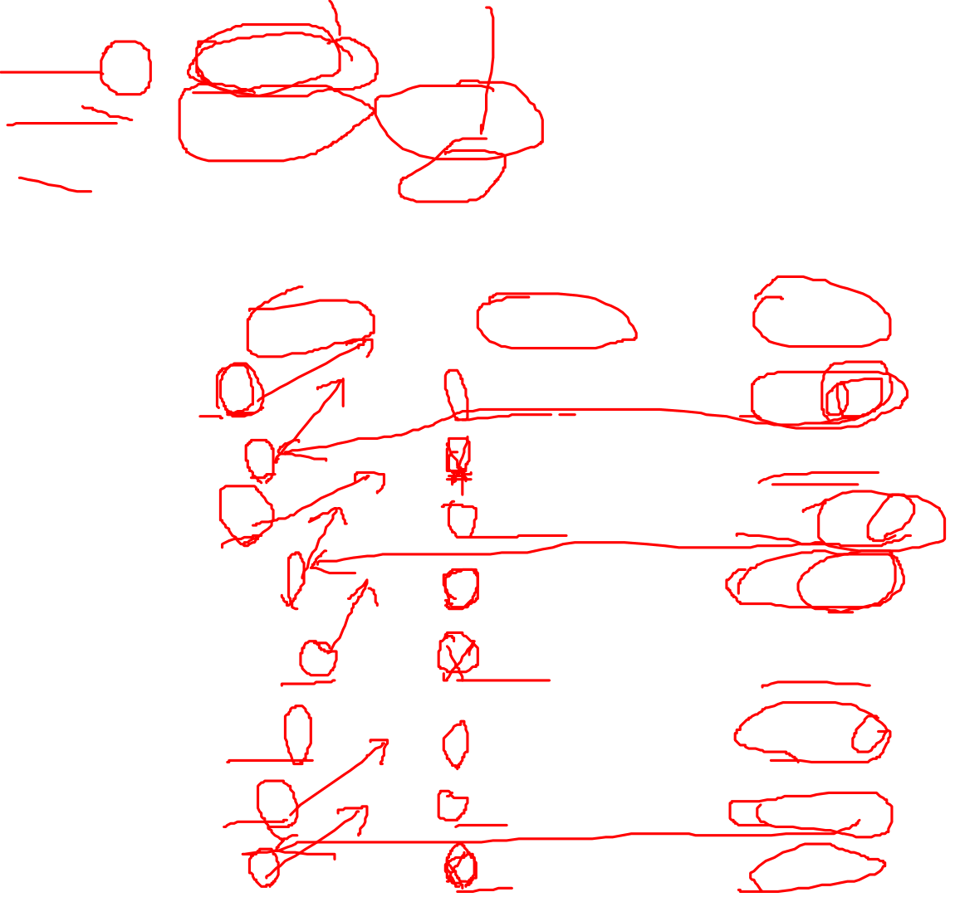
 | a | + | * | $
S | S→aS’
S’ | S’ → SOS’ | S’ → ɛ | S’ → ɛ | S’ → ɛ
O |  | O →+ | O →*
LL(1)分析过程模拟
step | stack | input | action
1 | $S | aa+a*$ | S→aS’
2 | $S’a | aa+a*$ | match
3 | $S’ | a+a*$ | S’ → SOS’
4 | $S’OS | a+a*$ | S→aS’
5 | $S’OS’a | a+a*$ | match
6 | $S’OS’ | +a*$ | S’ → ɛ
7 | $S’O | +a*$ | O →+
8 | $S’+ | +a*$ | match

Slide 15
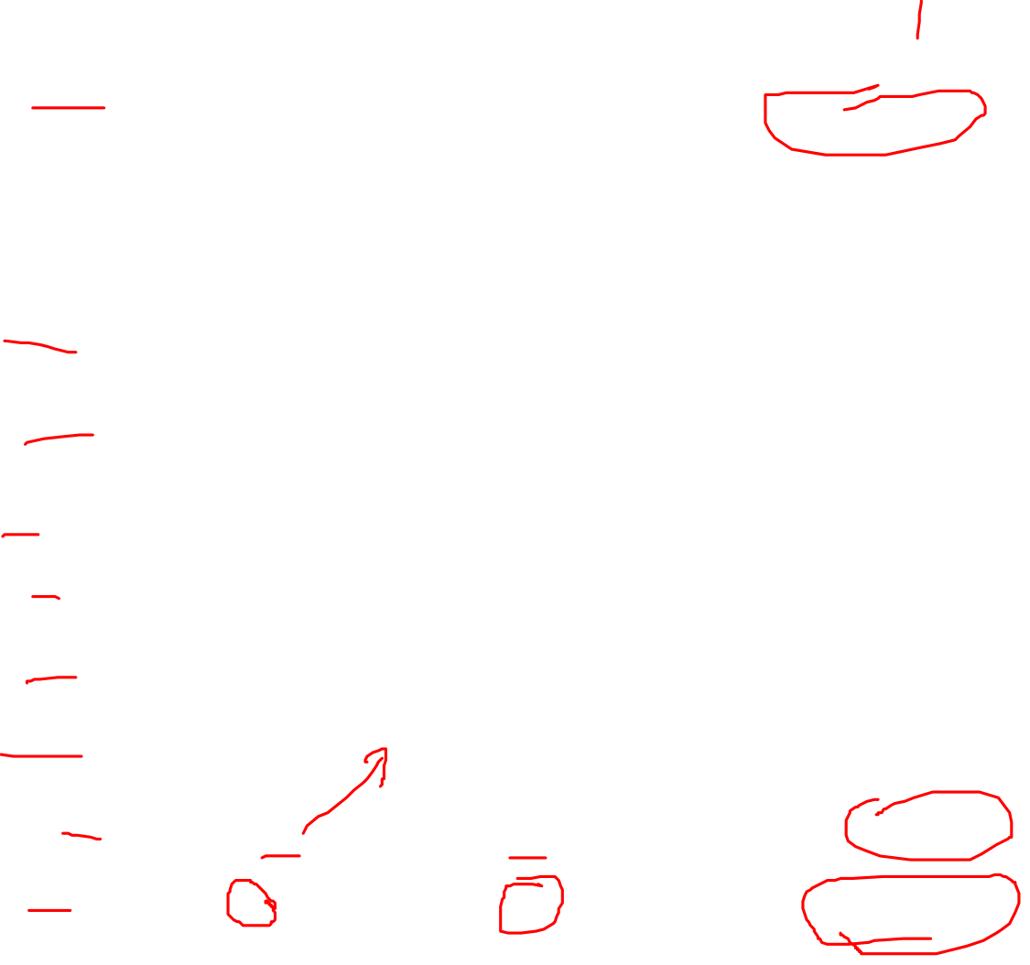
 | a | + | * | $
S | S→aS’
S’ | S’ → SOS’ | S’ → ɛ | S’ → ɛ | S’ → ɛ
O |  | O →+ | O →*
step | stack | input | action
9 | $S’ | a*$ | S’ → SOS’
10 | $S’OS | a*$ | S→aS’
11 | $S’OS’a | a*$ | match
12 | $S’OS’ | *$ | S’ → ɛ
13 | $S’O | *$ | O →*
14 | $S’* | *$ | match
15 | $S’ | $ | S’ → ɛ
16 | $ | $ | accept

